Slide 1
Software System Modeling

Slide 2

Agenda
Get to know
Laboratory structure
General Presentation

Slide 3
Introduction
Subject: Software System Modeling. UML Diagrams, Modeling, Design Patterns etc.
Requirements: To be active. Attendance is not mandatory. Evaluation based on team project.
About me: Andrian Babii, Java back-end developer at Endava
About you: Name, professional interests, fun fact.

Slide 4
Tools
https://www.lucidchart.com/
https://www.websequencediagrams.com/
https://yuml.me/
https://mermaid-js.github.io/
https://app.diagrams.net/

Slide 5
UML

Slide 6
UML is not a process of designing solutions, but merely a way of communicating it without getting into implementation language specifics.
UML 2 has many types of diagrams, which are divided into two categories. Some types represent structural information, other represent general types of behavior, including a few that represent different aspects of interactions.

Slide 7
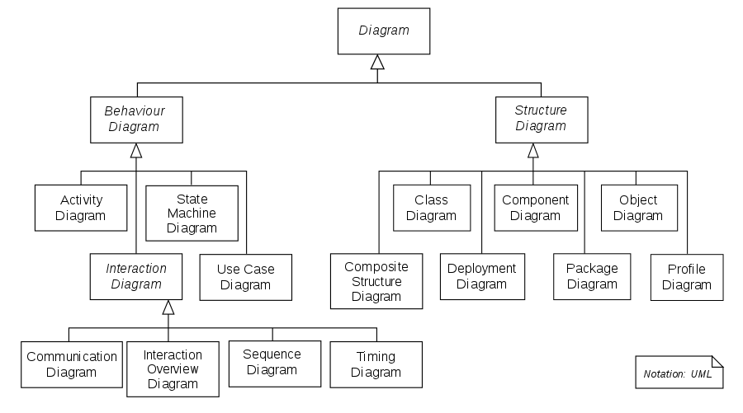

Slide 8
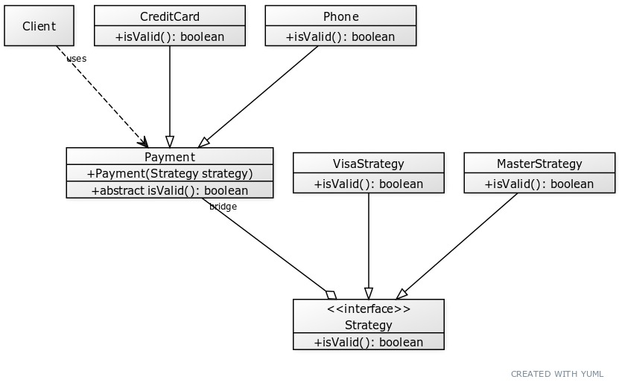
Poll
What type of diagram is presented in the following image?
Class
Package
Interaction
Use case

Slide 9
Class diagram is the backbone of object-oriented modeling - it shows how different entities (people, things, and data) relate to each other. In other words, it shows the static structures of the system.
The purpose of the class diagram can be summarized as:
Analysis and design of the static view of an application;
To describe the responsibilities of a system;
To provide a base for component and deployment diagrams; and,
Forward and reverse engineering.

Slide 10
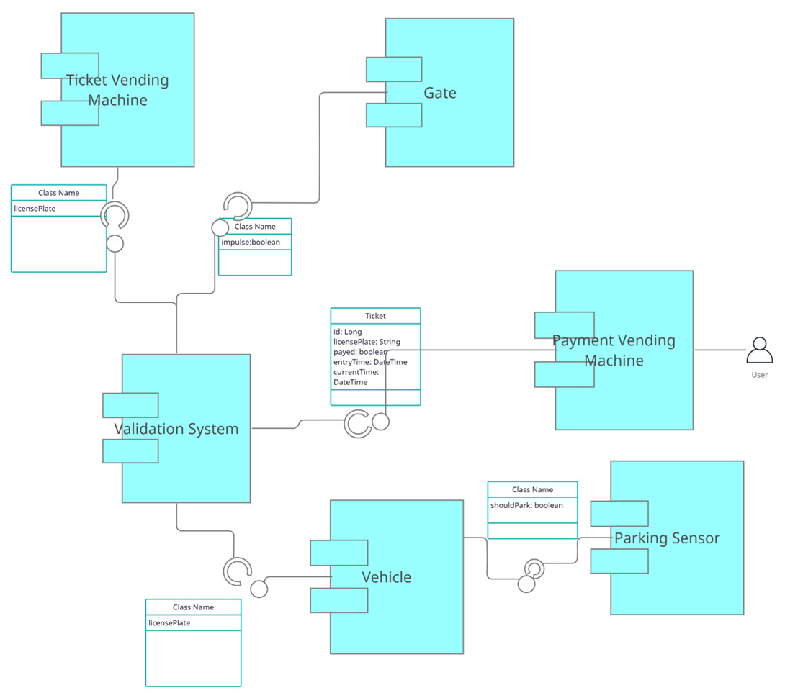
Poll
What type of diagram is presented in the following image?
State machine
Interaction
Component
Use case

Slide 11
Component diagrams are essentially class diagrams that focus on a system's components that often used to model the static implementation view of a system.
A component diagram breaks down the actual system under development into various high levels of functionality. Each component is responsible for one clear aim within the entire system and only interacts with other essential elements on a need-to-know basis.

Slide 12
Exercise
Design a parking lot using class diagrams.

Slide 13
Steps:
Gather product requirements (make any reasonable assumption). Try to eliminate confusion and clear things up.
Draw a diagram of the class hierarchy you are thinking of. Ignore for the moment any scalability/performance issue and just pretend the simple approach is the good one.

Slide 14
Requirements:
The parking lot should have multiple floors where customers can park their cars.
The parking lot should have multiple entry and exit points.
Customers can pay the tickets at the automated exit panel or to the parking attendant.
Customers can pay via both cash and credit cards.
Customers should also be able to pay the parking fee at the customer’s info portal on each floor. If the customer has paid at the info portal, they don’t have to pay at the exit.
The system should not allow more vehicles than the maximum capacity of the parking lot. If the parking is full, the system should be able to show a message at the entrance panel and on the parking display board on the ground floor.
Each parking floor will have many parking spots. The system should support multiple types of parking spots such as Compact, Large, Handicapped, Motorcycle, etc.
The Parking lot should have some parking spots specified for electric cars. These spots should have an electric panel through which customers can pay and charge their vehicles.
The system should support parking for different types of vehicles like car, truck, van, motorcycle, etc.

